Slide 1
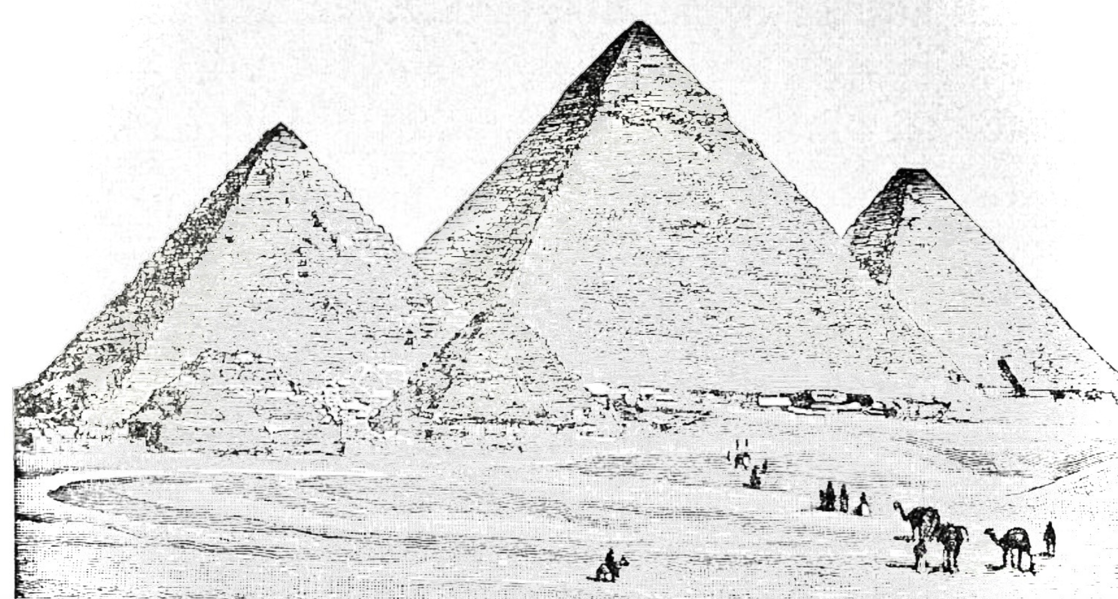
DSO 552 Fall 2021
Class 1 Basic Intro
By Arsames Qajar qajar@usc.edu

Slide 2
Agenda
Course Overview
SQL Basics
Install SQL
pgAdmin guide
Review Database Systems Concepts
Introduce SQL data definition and manipulation languages (DDL and DML respectively)
CREATE, ALTER, DROP tables & databases (DDL)
INSERT & SELECT data in tables (DML)
Assignment #1 on BB due next week

Slide 3
Course Overview Review course information, format,
assignments/exam, objectives & topics

Slide 4
Course Objectives
Explain the value and mechanics of relational databases using SQL
Describe the basics of the data management and storage industry
Apply knowledge of large scale SQL databases to manage, query and analyze business processes
Perform database management and analytics related to different industries
Design and implement a comprehensive database application

Slide 5
Course Topics
SQL Basics & Database Systems Concepts
Multiple Tables, Subqueries
Joins, Grouping, Summarizing
CTEs, Window functions, Adv SQL

Slide 6
Course Information
Grader → tbd
Office Hours: (possibly) Thursday 4-5pm
Keeping in touch
Email me at qajar@usc.edu
Slack → will send out link on BB today
Notes:
Midterm + Final = 2
Need 14 classes

Slide 7
Course Format
Recordings, announcements & assignments/exam on Blackboard
Software
pgAdmin4 (required)
python/Jupyter notebook (optional)
Participation 🍿 but not graded
🍿 i.e. randomly calling on students to respond to questions

Slide 8
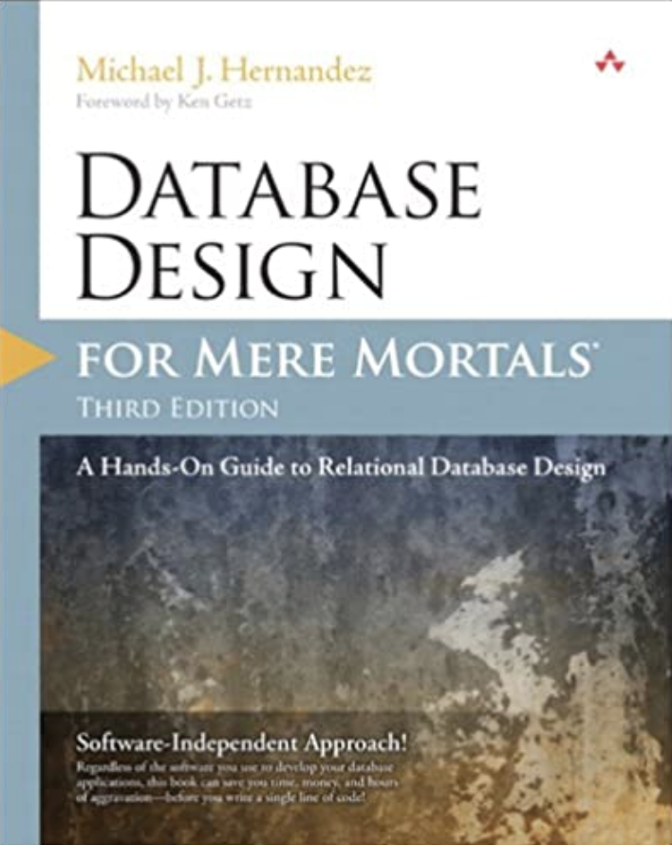
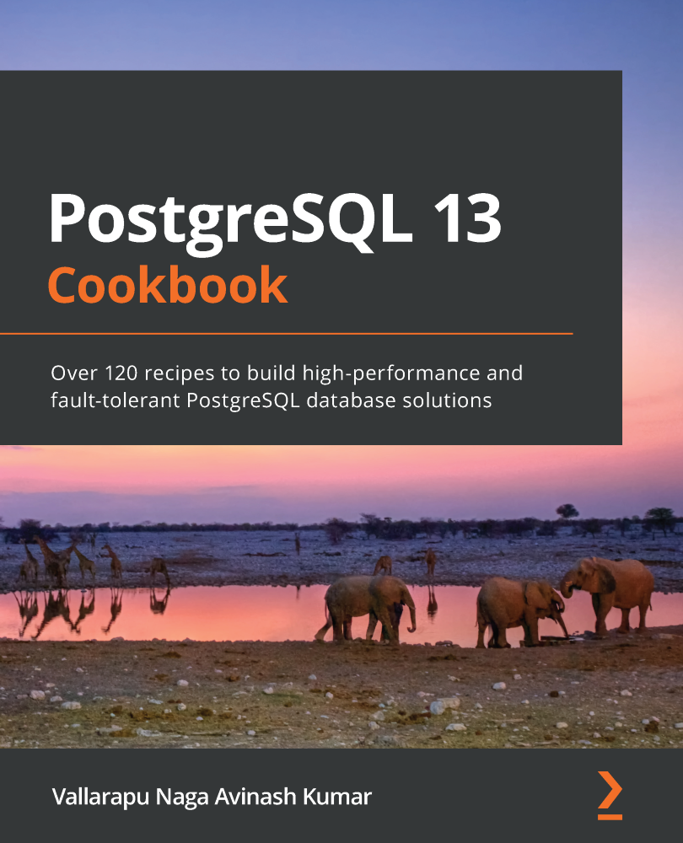
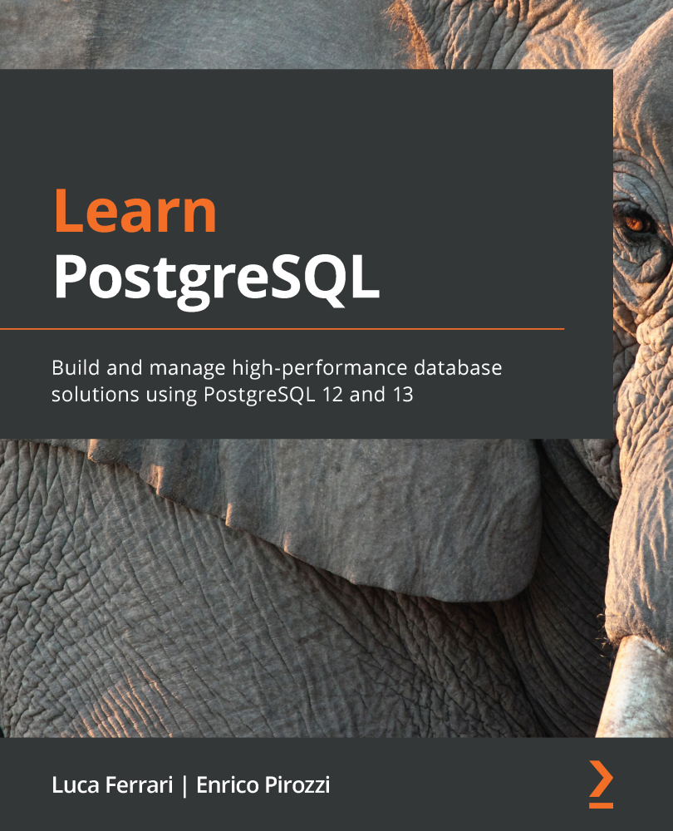
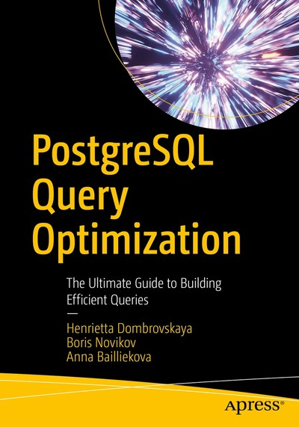
Textbook(s) (optional)
PostgreSQL Query Optimization: The Ultimate Guide to Building Efficient Queries By multiple
Database Design for Mere Mortals 3e By Michael J. Hernandez
PostgreSQL 13 Cookbook By Vallarapu Naga Avinash Kumar
Learn PostgreSQL By Luca Ferrari, Enrico Pirozzi

Slide 9
Assignments & Exams
All Assignments & Exams
due by 11:59pm of due date
save file format in .sql → last name + assignment # (e.g. for me, it would be “qajar#1.sql”)
grading disputes must be addressed with your grader within 24 hours of having the homework returned
Exam (40%) on 9/27
Late Assignment
Score = (Your raw score) * (1 - 0.1 * (# of days past deadline)

Slide 10
Questions ?

Slide 11
SQL Basics - Installation Download/install SQL

Slide 12
SQL Installation
Click here for installation guide
Follow steps under INSTALL SQL

Slide 13
SQL Basics - Database Systems Review database systems, relational model e.g. tables, relationships, keys, etc

Slide 14
Database Systems
Databases
Databases
The Relational Model
Tables
Primary & Foreign Keys
Relationships
SQL (i.e. postgres)
Get started with query tool in pgAdmin
Load datasets & create databases, tables
SELECT statement practice
Notes:
Anyone give a definition of a database?

Slide 15
Database Systems
Name 3 characteristics of a database system other than storage.
Notes:
Anyone give a definition of a database?
Relation
Organization of Data: in form of rows and tables
Security
Data Sharing

Slide 16
Database Systems Definitions
Database is an organized collection of interrelated data
Typically entails some data modeling process (not to be confused with data models e.g.
Data modeling vs Data Models → Modeling is how information is logically organized within a certain Data Model; a Data Model deals with a specific storage structure e.g. NoSQL, SQL, Hierarchical
Persistent storage usually: data persists
DBMS allows the definition, creation, querying, update, and administration of databases
Query language → Create, restore, modify, query, backup where user specifies what is needed not how
Manages & stores metadata i.e. data about data such as column data types about a table or database size¹
Data Integrity/constraints e.g. ensure proper data type is inserted into a column² , indexes
Multi-user accessibility & privileges
Data Independence
Manage/create supporting structures (e.g. indexes)
¹ typically found in the information schema but also known as the data dictionary; whereas database size is found in the system catalog
² different kinds of integrity constraints e.g. domain, entity, referential integrity(p.126-128)
Notes:
-Metadata all found in the system catalog or in Postgres known as the “catalogs”. It also has the information schema that contains relevant metadata about db, tables, columns etc. But the catalogs has all that and more e.g. replication, cluster management/details, etc ====> see: https://learning.oreilly.com/library/view/learn-postgresql/9781838985288/eae2bc8b-cbf3-4657-afb9-d348fdfa8460.xhtml learn - postgresql on Safari books
-i.e. data can be used/shared by more than one person and/or application (i.e. scalable) & RBAC

Slide 17
Database Systems Definitions cont’d
Table or relation: is a set of rows and columns with a unique identifier
Represents single, specific subject
Is the sequence of columns or rows significant? No
Column/attribute: a characteristic of a table with a distinct name
Values in column must conform to a certain data type
The range of values for a specific column is its attribute domain
Row/Record/Tuple: is a unique instance of a table that is composed of fields
Generally has a primary key (PK) field that uniquely identifies each record
Can the PK be a combination of attributes? Yes, combine other fields to make a unique key
Relationship an association among entities
One to One (1:1) → country to capital, One to Many (1:M) → painter to paintings, Many to Many (M:N or M:M) + associative/linking/bridging table → students to courses
Foreign Key a column or set of columns in a table that connects it to another table
Notes:
Essentials of database management p.124

Slide 18
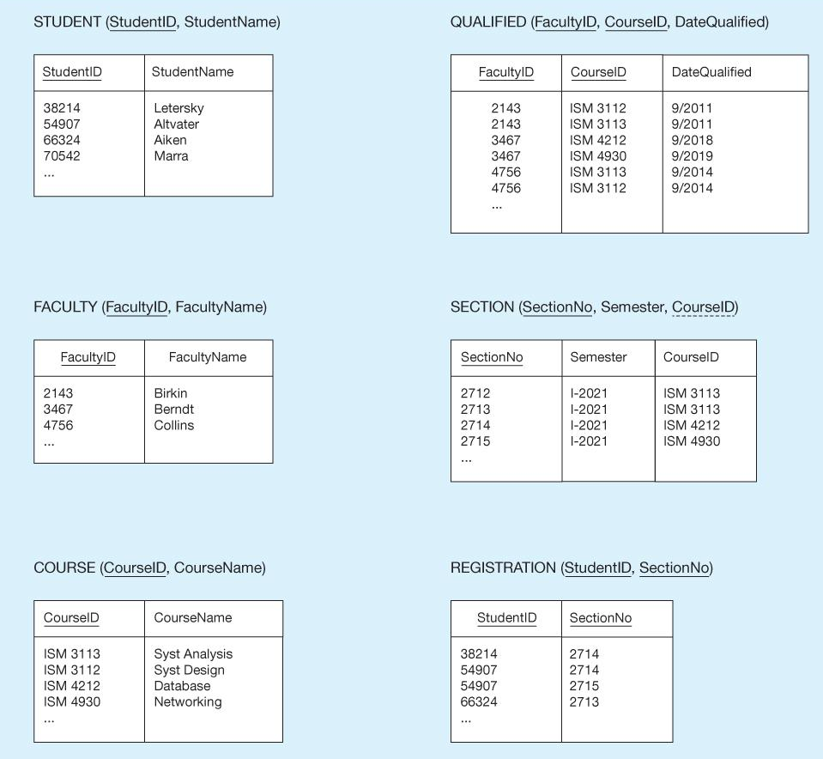
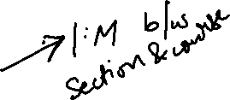
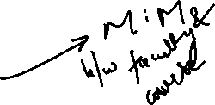
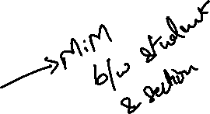
Database Systems
Table Schema
Database
Schema
Notes:
Chapter 5 modern database management
Schema → description of a particular collection of data
https://www.db-book.com/db7/slides-dir/PDF-dir/ch2.pdf

Slide 19
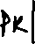
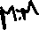
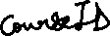
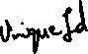
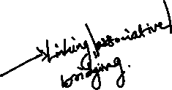
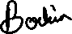
Database Systems
What kind of table is the QUALIFIED or REGISTRATION table ?
In the STUDENT table, what kind of column is StudentID ?
What type of relationship exists between the FACULTY and COURSE table ?
What is the value for the first tuple in FacultyName column of the FACULTY table ?
What type of relationship exists between the COURSE and SECTION table ? Can you identify the foreign key(s) ?
Notes:
Essentials of database management p.124

Slide 20
Database Systems
Associative
Primary Key
M:N
Birkin
1:M &
CourseID
Notes:
Chapter 5 modern database management
Schema → description of a particular collection of data

Slide 21
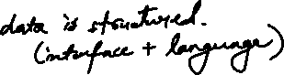
Database Systems Summary
Database systems comprised of 2 main structures
Databases (storage + modeling)
DBMS to manage/administer/interact with databases
Essential building blocks
Rows, Columns, Tables & Relationships
Questions ?
Next: Uploading data and Querying 😀
Notes:
Why is this a bad definition

Slide 22
SQL Basics Data Definition Language → CREATE, DROP, ALTER the
database and respective tables along with
Data manipulation language using SELECT

Slide 23
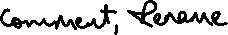
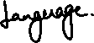
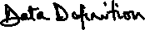
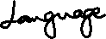
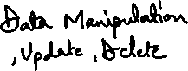
Outline
Open pgAdmin
Datasets folder here
→ Intro to DDL
CREATE, ALTER, DROP for tables and databases
Intro to DML
INSERT & SELECT

Slide 24
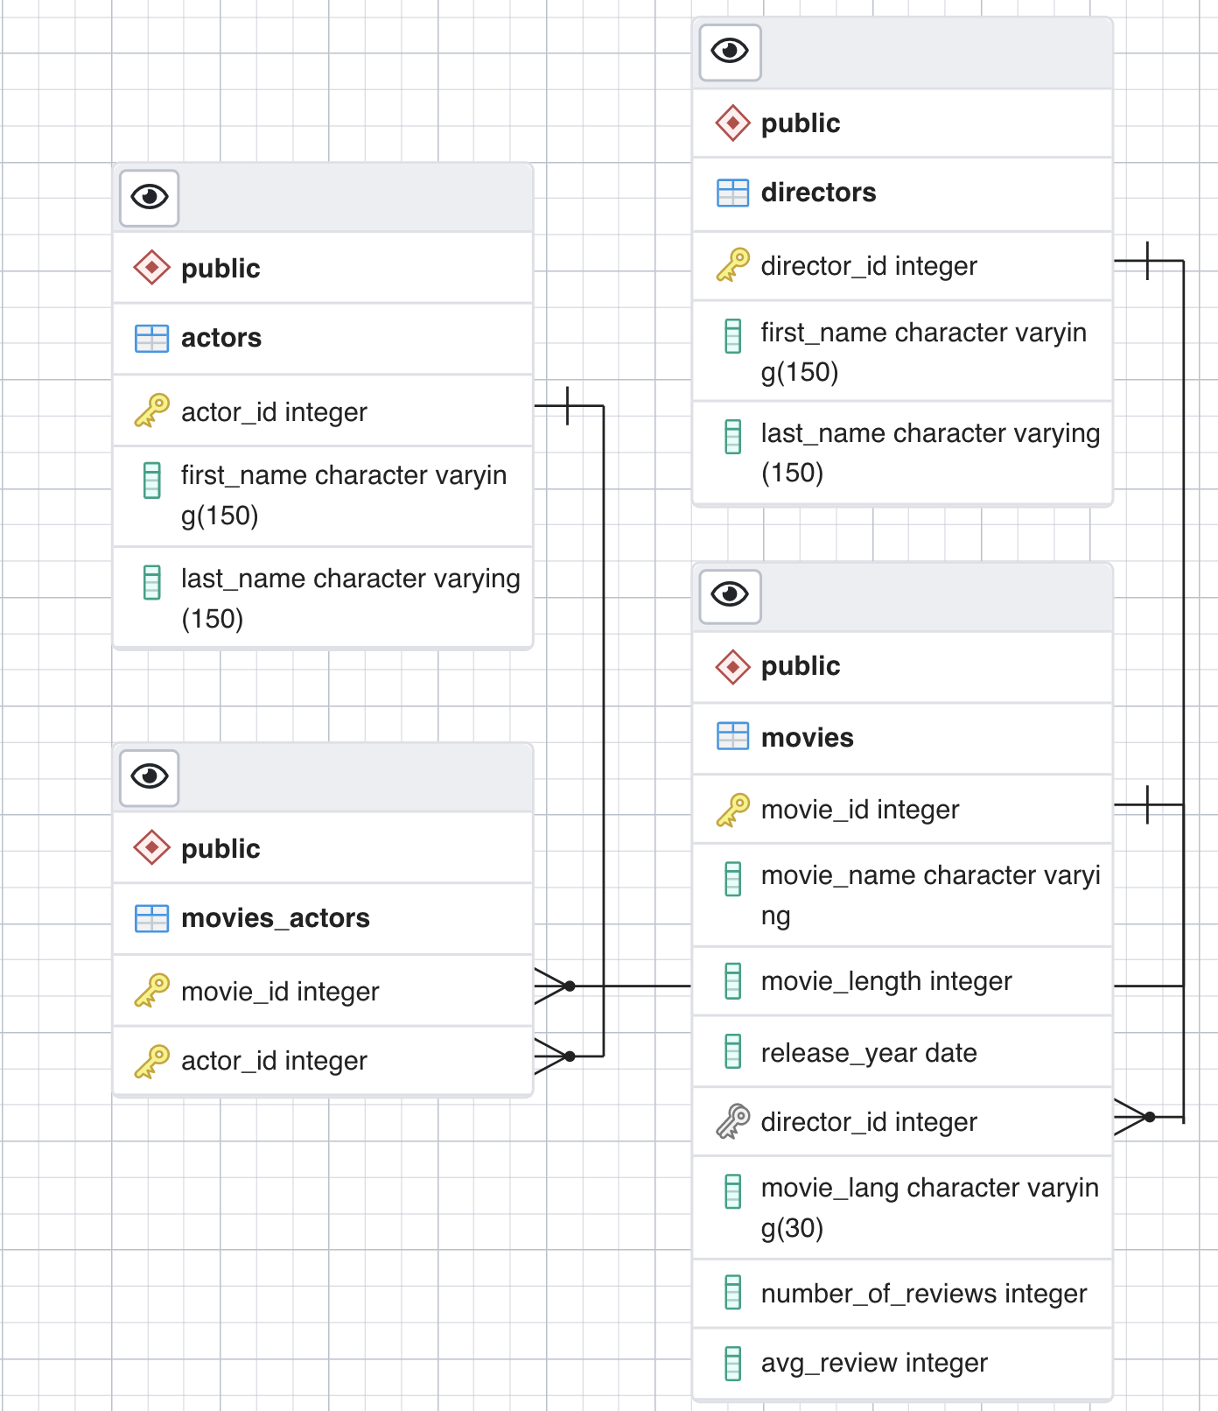
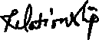
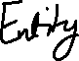
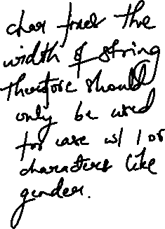
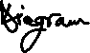
ERD Basics
movie_sample database
Our Schema for our DDL queries
Notes:
Point out data types

Slide 25
Create Table
syntax
CREATE TABLE keyword + IF NOT EXISTS option which avoids error
CREATE TABLE [IF NOT EXISTS] table_name (
col_1 datatype(length) column_contraint,
price NUMERIC NOT NULL CHECK(price>0),
col_3 datatype(length) column_contraint,
Director_id REFERENCES directors(director_id)
UNIQUE (col_x), CONSTRAINT constraint_name PRIMARY KEY (col_x,...),
CONSTRAINT constraint_name FOREIGN KEY (col_y)
REFERENCES table ON UPDATE/DELETE [ON UPDATE CASCADE| SET NULL| SET DEFAULT| NO ACTION]
[ON DELETE CASCADE| SET NULL| SET DEFAULT| NO ACTION], ...
CHECK (condition)
);
Columns have: name, datatype, and constraint
Table constraints including primary key, foreign key, and check constraints.
CONSTRAINT constraint_name is optional

Slide 26
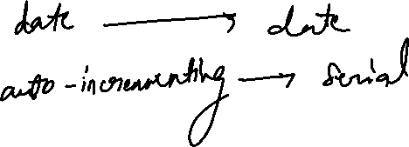
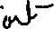
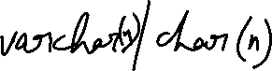
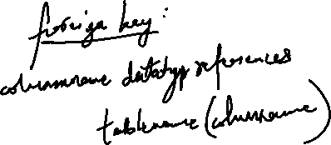
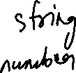

Slide 27
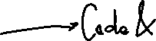
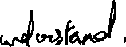
Data Types
Quick Review
Data Type | Definition
BOOLEAN | TRUE or FALSE
CHAR / VARCHAR / TEXT | fixed/ variable / no limit
DECIMAL/ NUMERIC | When exact precision is needed e.g. financial data. Numeric also used for monetary data.
BIGINT / INT/ SMALLINT / TINYINT | 19 digits / 10 digits
FLOAT/ DOUBLE PRECISION | Approximate! When exact precision not needed
MONEY | Not good for currency conversions, use numeric.
DATE, *TIME, TIMESTAMP *can set with timezone* | YYYY-MM-DD, HH:MI:SS,
Most numeric types are one of the following:
Exact (SMALLINT, INTEGER, BIGINT, NUMERIC(p,s), and DECIMAL(p,s))
Approximate (FLOAT(p), REAL, and DOUBLE PRECISION)
MOST USED Data types
Integer
Numeric
Text
Date
Time
Timestamp
Integer is the most used for numeric data types
Numeric for precision, but slow computation compared to integer & double precision
Notes:
integer for whole numbers, numeric for possibly fractional numbers, text for character strings, date for dates, time for time-of-day values, and timestamp

Slide 28
Constraints
Domain Constraints
NOT NULL
CHECK(condition) to ensure a column meets some parameters e.g. CHECK(price >-1)
Referential Integrity Constraints i.e. Foreign Key
NO ACTION - if parent table receives an update/delete query, error is raised & action is rollbacked i.e. leave blank
CASCADE - updates/deletes to rows in parent affect corresponding rows in child table
SET NULL - sets corresponding rows in child table to NULL
Entity Constraints
PRIMARY KEY(col_x, …) must be a unique non-NULL value for each row. Could be more than one column
UNIQUE (col_y) ensures other columns are unique e.g. email

Slide 29
SQL DDL ALTER TABLE syntax
ALTER Table statement: ALTER TABLE table_name action;
List of actions
Add a column
Drop a column
Change the data type of a column
Rename a column
Set a default value for the column.
Add a constraint to a column.
Rename a table
Notes:
https://www.postgresql.org/docs/current/catalog-pg-type.html
pg_type from the system catalog

Slide 30
SQL Basics - DML Data Manipulation Language → SELECT, Sorting information and
other clauses to transform our data

Slide 31
Outline
If you haven't, please download here
Intro to DML
Review the INSERT & upload data
SELECT statements
Switch to pgAdmin for In Class SQL

Slide 32
INSERT statement (DML)
Syntax: INSERT INTO table (columnlist)
VALUES (), ()...;
Note
(Columnlist) can be any or all of the fields within the table
Data values on insert should be the right format

Slide 33
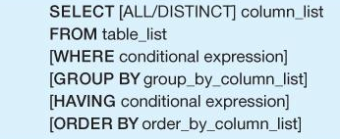
SELECT statement (DML)
Today’s focus:
SELECT
Notes:
DDL – Data Definition Language DQl – Data Query Language DML – Data Manipulation Language DCL – Data Control Language

Slide 34
SELECT statement (DML)
Good practice to specify fields to project, retrieve, manipulate
Limiting number of results not to overload database
SELECT columns… FROM table LIMIT # of records needed
DISTINCT keyword must be applied to remove duplicates in results
Other
case insensitive (SELECT or select)
use double single quote to resolve quote inside string → 'O''Sullivan'

Slide 35
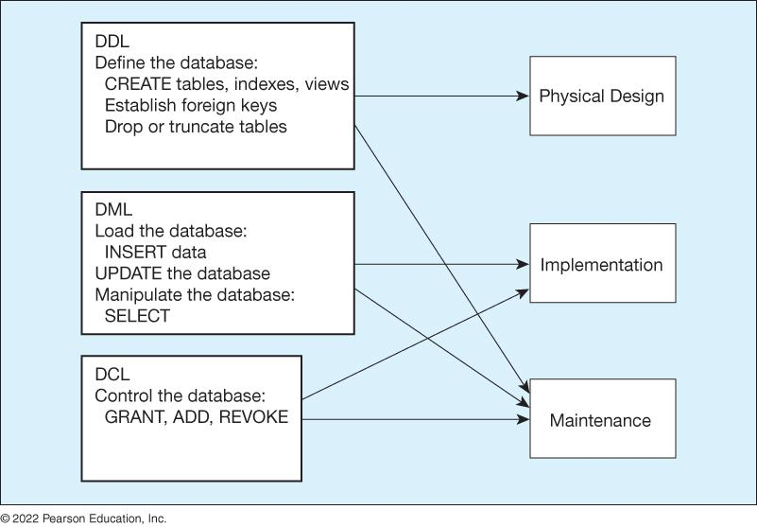
SQL: DML, DDL et al.

Slide 36
Extra….

Slide 37
Links/Resources
Postgresql create table
Copy data from file
Data Types & explanations:
Data types documentation, and this and this
Numeric data types here
Tables & data types review (AWS)
PRIMARY KEY constraint
Table & column constraints
Create Table
Alter Table
Psql shell commands

Slide 38
Postgres Data Types Data types documentation
BOOLEAN TRUE or FALSE
CHAR Fixed length string (padded with blanks) e.g. CHAR(10)
VARCHAR Variable length string e.g. VARCHAR(50)
BIT Bit string e.g. BIT(4) can store '0101'
NUMERIC or Exact numeric data type e.g. NUMERIC(7,2) = 7 digits, 2 decimal places
DECIMAL
INTEGER Integer data only
SMALLINT Smaller space than INTEGER
FLOAT or Approximate numeric data types.
REAL
DATE Stores YEAR, MONTH, DAY (“YYYY-MM-DD”)
TIME Stores HOUR, MINUTE, SECOND (‘hh:mm:ss[.f] ' e.g. '15:00:00')
TIMESTAMP Stores date and time data. (‘YYYY-MM-DD hh:mm:ss[.f] ' e.g. ‘1975-05-17 15:00:00')
INTERVAL Time interval.
CHARACTER Stores a character array (e.g. for a document) LARGE OBJECT
BINARY LARGE Stores a binary array (e.g. for a picture, movie)
OBJECT

Slide 39
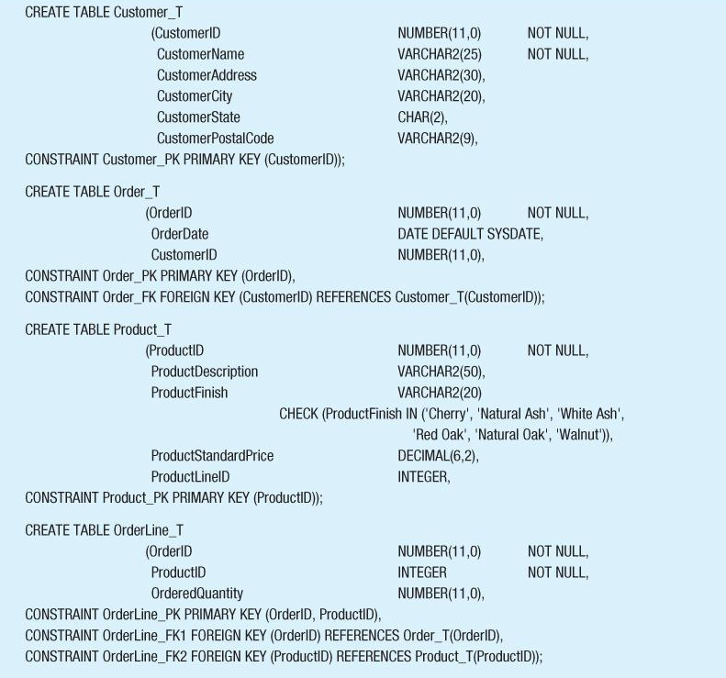
Create Table Example

Slide 40
Database Systems
Schemas how should I organized my data ?
Normalization is there redundant data ?
Views/Stored Procedures what kinds of questions of my data will I ask/require most often?
Access Control should all users of the data have the same level of access?

Slide 41
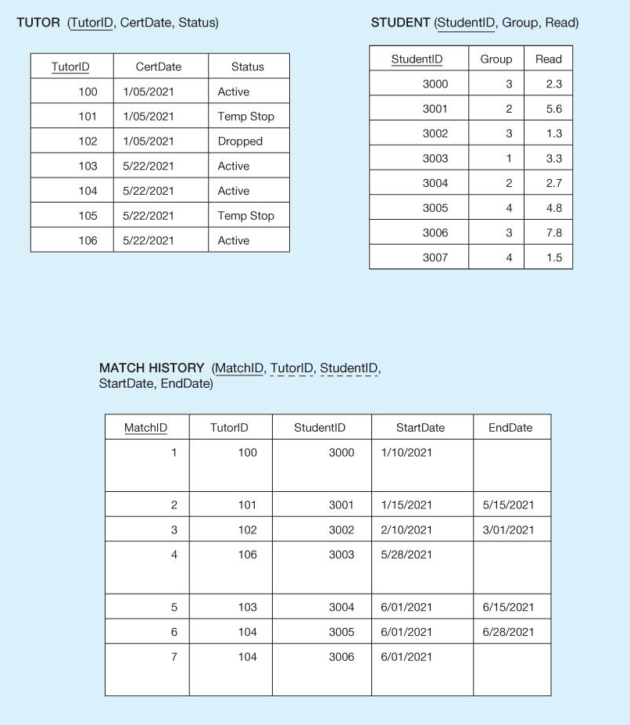
Database Systems Definitions cont’d
Notes:
Chapter 5

Slide 42
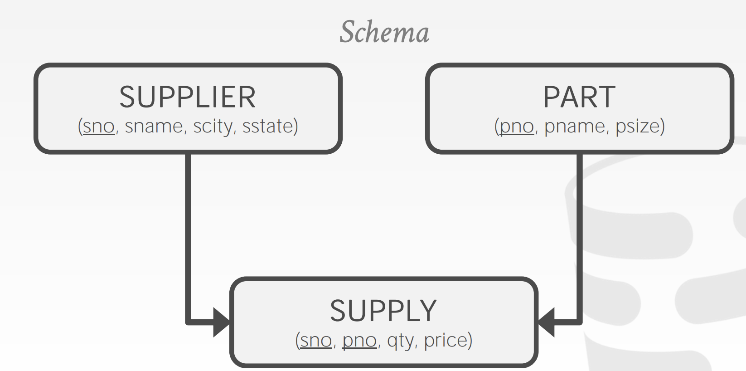
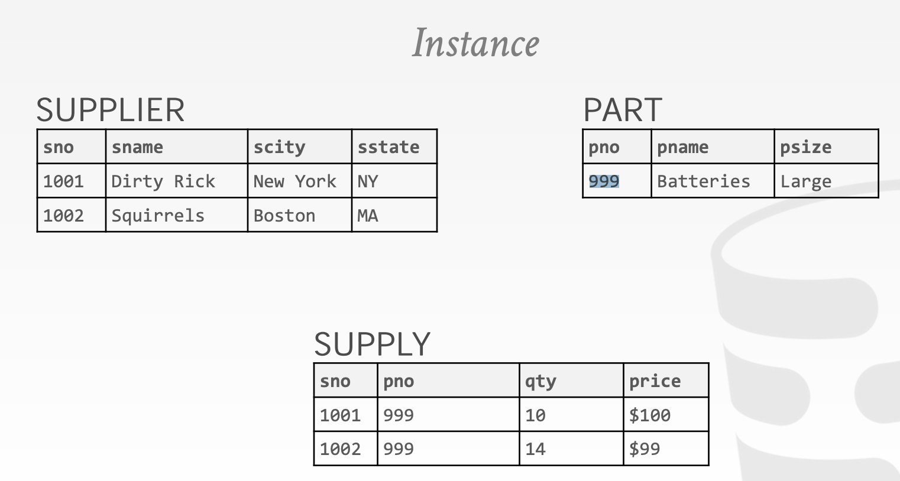
Databases Schemas
Notes:
https://www2.seas.gwu.edu/~bhagiweb/cs2541/lectures/rel-intro.pdf

Slide 43
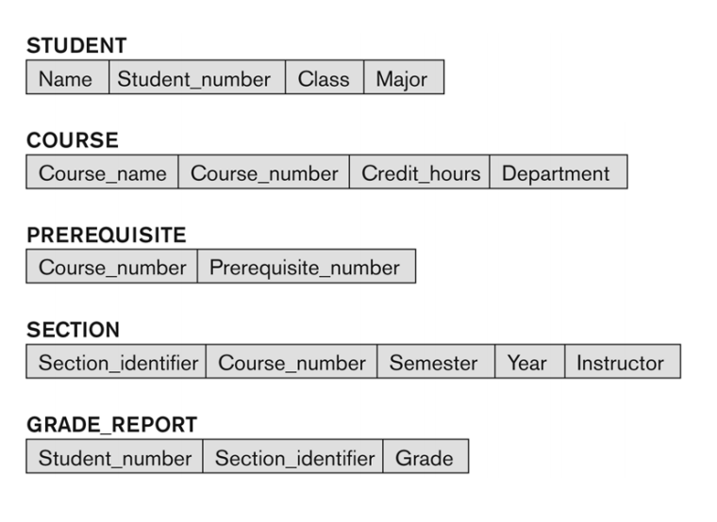
Databases University schemas
Notes:
https://www2.seas.gwu.edu/~bhagiweb/cs2541/lectures/rel-intro.pdf

Slide 44
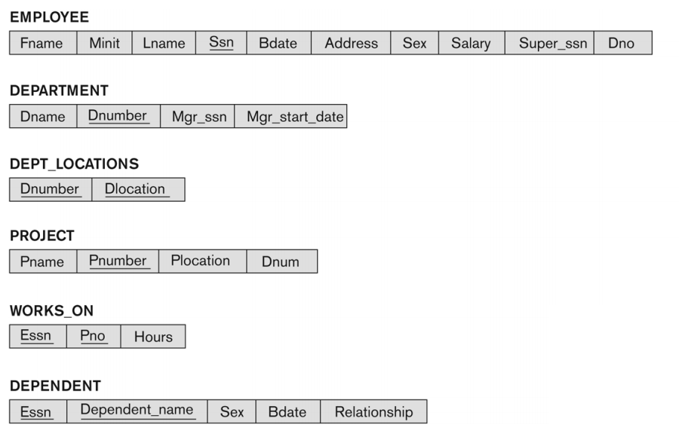
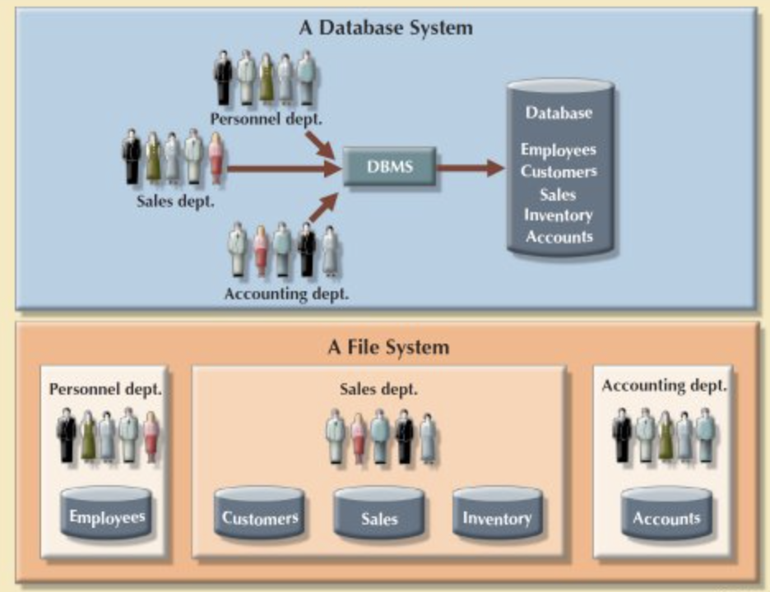
Databases Company schemas
Notes:
https://www2.seas.gwu.edu/~bhagiweb/cs2541/lectures/rel-intro.pdf

Slide 45
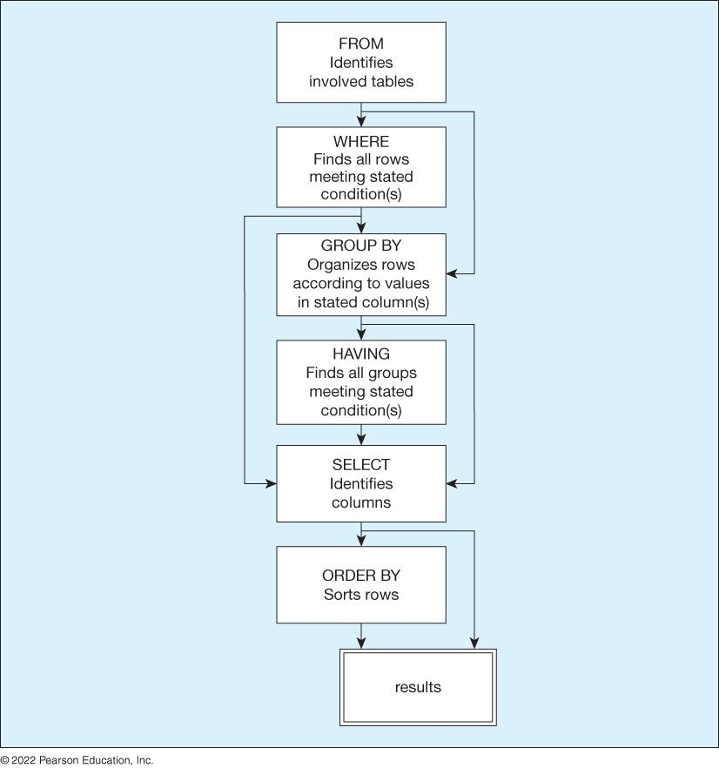
SQL How SQL processes your query
Notes:
https://www.czobel.bit.vt.edu/bit4514/handouts/lecture%2001.pdf p.4
Database vs excel https://365datascience.com/tutorials/sql-tutorials/database-vs-spreadsheet/
https://courses.cs.duke.edu//fall12/compsci316/lectures/01-intro-notes.pdf

Slide 46
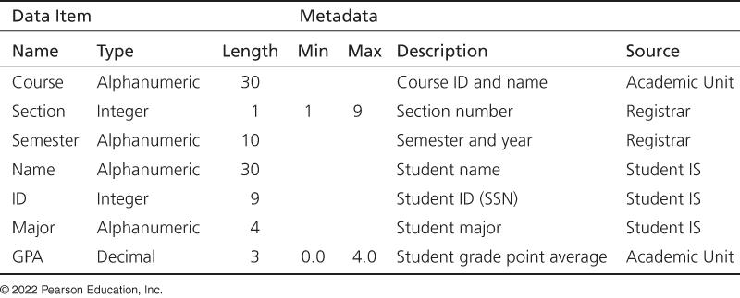
Metadata example
Notes:
Why is this a bad definition

Slide 47
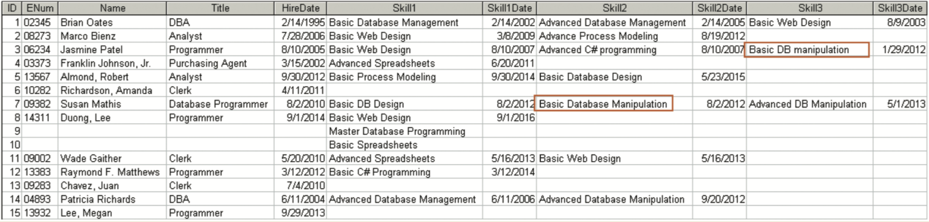
Databases File vs Database
Notes:
Why is this a bad definition

Slide 48
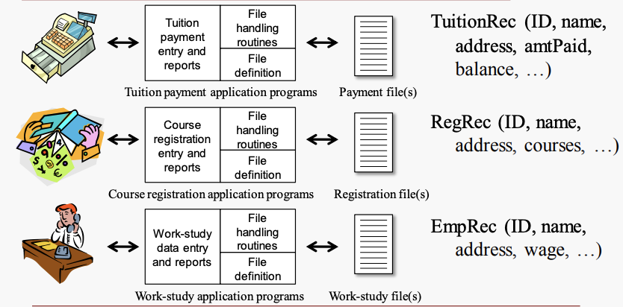
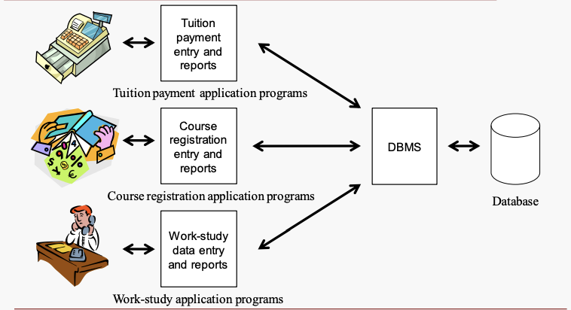
Databases File vs Database
Excel i.e. flat file system
Database
Notes:
https://www.czobel.bit.vt.edu/bit4514/handouts/lecture%2001.pdf p.4
Database vs excel https://365datascience.com/tutorials/sql-tutorials/database-vs-spreadsheet/
https://courses.cs.duke.edu//fall12/compsci316/lectures/01-intro-notes.pdf

Slide 49
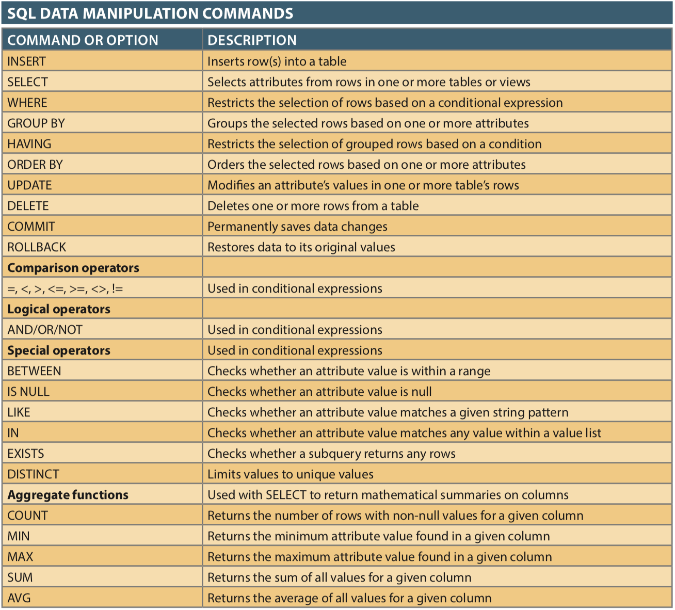
SQL Basics

Slide 50
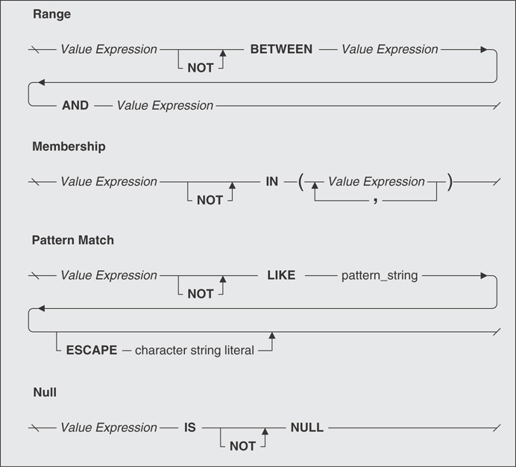
Logical Operator - NOT

Slide 51
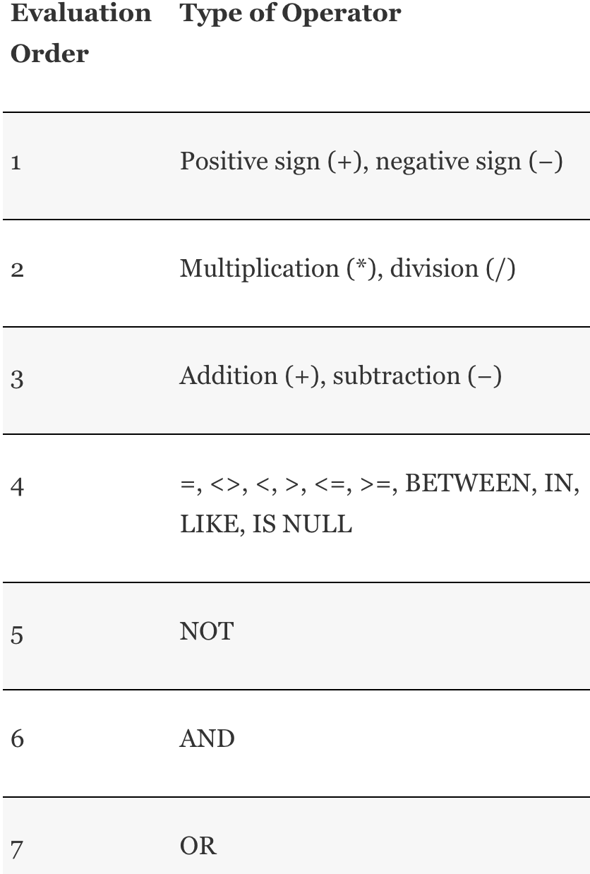
Orders of Precedence

